Slide 1



Introducere în analiza datelor de mari dimensiuni
Titlul proiectului: Educație și dezvoltare în era digitală
Cod proiect: POCU/860/3/12/143072
Importul și exportul datelor în/din R
(slide-urile sunt în limba engleză)
By Marin Fotache

Slide 2
Web sites with R tutorials for data input/output
R Data Import/Export
http://cran.r-project.org/doc/manuals/r-release/R-data.html
Beginner's guide to R: Get your data into R
http://www.computerworld.com/article/2497164/business-intelligence/beginner-s-guide-to-r-get-your-data-into-r.html
Reading/Writing Data: Part 1
https://www.youtube.com/watch?v=aBzAels6jPk&index=9&list=PLjTlxb-wKvXNSDfcKPFH2gzHGyjpeCZmJ
Reading/Writing Data: Part 2
https://www.youtube.com/watch?v=aBzAels6jPk&index=9&list=PLjTlxb-wKvXNSDfcKPFH2gzHGyjpeCZmJ
Importing Data Into R from Different Sources
http://www.r-bloggers.com/importing-data-into-r-from-different-sources/
Data Import & Export in R
http://science.nature.nps.gov/im/datamgmt/statistics/r/fundamentals/index.cfm

Slide 3
Web sites with R tutorials for data input/output (cont.)
Reading data from the new version of Google Spreadsheets
http://blog.revolutionanalytics.com/2014/06/reading-data-from-the-new-version-of-google-spreadsheets.html
This R Data Import Tutorial Is Everything You Need
https://www.datacamp.com/community/tutorials/r-data-import-tutorial#gs.wWkdN3Y
Importing Data Into R - Part Two - Read more at: https://www.datacamp.com/community/tutorials/importing-data-r-part-two#gs.odSNCOo
http://www.r-bloggers.com/r-tutorial-on-reading-and-importing-excel-files-into-r/
https://vimeo.com/130548869
http://www.r-bloggers.com/importing-data-into-r-part-two/

Slide 4
Loading data into statistical packages
Traditional solutions:
Direct import from external data files (Excel, CSV, text files etc.) using their menus
Save intermediate results from the data sources into common format files (XML, CSV, JSON ) and then import these intermediate files into R;
Create data sources using ODBC or JDBC and import the data into R
Some more recent options:
Customized ETL procedures
Connecting to special APIs or web/data services which provide data sets in formats easy to import (e.g. Google Analytics)
Import data from web servers log into NoSQL data stores
Performing database query in a database server directly from the statistical package.

Slide 5
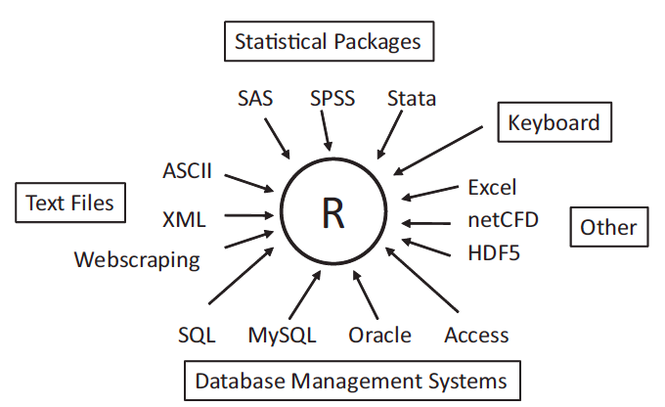
Sources of Data in R (adapted from [Kabacoff, 2011])
APIs
NoSQL Data Stores
Hadoop

Slide 6
Loading data into an R session
Source (File) Type | Base R functions | Recommended packages | Other packages
.RData file | load()
Clipboard | read.table
Delimited text file (.txt) | read.table | readr read_tsv read_delim
Comma separated files (.csv) | read.table | readr read_csv read_delim
Excel files (.xlsx/.xls) |  | readxl read_excel excel_sheets | openxlsx xlsReadWrite XLConnect xlsx
PostgreSQL dabase tables/views |  | RPostgreSQL | DBI

Slide 7
Loading data into an R session (cont.)
Source (File) Type | Base R functions | Recommended packages | Other packages
SPSS data file |  | rio import | foreign read.spss haven read_spss
STATA data file |  | rio import | foreign read.dta haven read_dta read_stata
SAS data file |  | rio import | foreign read.ssd haven read_sas

Slide 8
Access Oracle databases through JDBC
Package ROracle was intended to provide access to Oracle databases
Unfortunately, now package ROracle is not available
Next example was inspired by http://www.r-bloggers.com/connecting-r-to-an-oracle-database-with-rjdbc/
As the name suggests, the solution needs dealing with some Java "things"
Requirements: JDK/JRE previously installed
Download ojdbc jar from www.oracle.com (in my case, ojdbc6.jar)
Set JAVA_HOME, set max. memory, and load rJava library
Sys.setenv(JAVA_HOME='/path/to/java_home')
on my Mac OS:
> Sys.setenv(JAVA_HOME='/Library/Java/JavaVirtualMachines/jdk1.7.0_45.jdk/Contents/Home')
> options(java.parameters="-Xmx2g")
> install.packages("rJava")
> library(rJava)

Slide 9
Access Oracle databases through JDBC (cont.)
Getting some information
Java version
> .jinit()
> print(.jcall("java/lang/System", "S", "getProperty", "java.version"))
classPath (just for the record)
> .jclassPath()
Load RJDBC package
> Install.packages(RJDBC)
> library(RJDBC)
Create connection driver and open connection
> jdbcDriver <- JDBC(driverClass="oracle.jdbc.OracleDriver",
classPath="/Users/admin/Downloads/ojdbc6.jar")

Slide 10
Access Oracle databases through JDBC (cont.)
Open connection
> jdbcConnection <- dbConnect(jdbcDriver,
+ "jdbc:oracle:thin:@//10.10.0.7:1521/orcl",
+ "bd2",
+ "bd2")
Launch the Oracle query and store the result into the data frame st
> st <- dbGetQuery(jdbcConnection,
+ "SELECT * FROM studenti")
Close connection
> dbDisconnect(jdbcConnection)

Slide 11
Saving/Exporting R data
Destination (File) Type | Base R functions | Recommended packages | Other packages
.RData file | save.image save
Delimited text file (.txt) | write.table | readr write_tsv write_delim | rio - export
Comma separated files (.csv) | read.table | readr write_csv write_delim | rio - export
Excel files (.xlsx/.xls) |  | writexl write_xlsx | openxlsx xlsReadWrite XLConnect xlsx rio
PostgreSQL dabase tables/views |  | RPostgreSQL | DBI

Slide 12
Saving/Exporting R data (cont.)
Source (File) Type | Base R functions | Recommended packages | Other packages
SPSS data file |  | rio export | foreign write.foreign haven write_sav
STATA data file |  | rio export | foreign write.foreign haven write_dta write_stata
SAS data file |  | rio export | foreign write.foreign haven write_sas

